Slide 1
MULTITHREADING
Kateryna Malash

Slide 2
AGENDA
Key Concepts
Multithreading in C#
Thread Life Cycle
Thread Properties
Thread Methods
Thread States
Thread Properties
Thread Creation
Thread with Parameters
Thread Synchronizing
Monitor
AutoResetEvent
Mutex
Semaphore
Timer
Useful Links

Slide 3
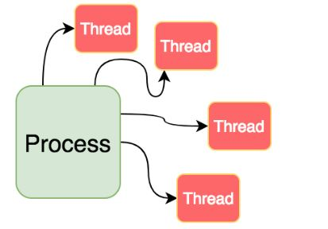
KEY CONCEPTS
Process
is the instance of a computer program
Process can be executed by one or many threads

Slide 4
KEY CONCEPTS
Thread
is the execution path of the program.
Each thread defines a unique flow of control.
Threads are lightweight processes

Slide 5

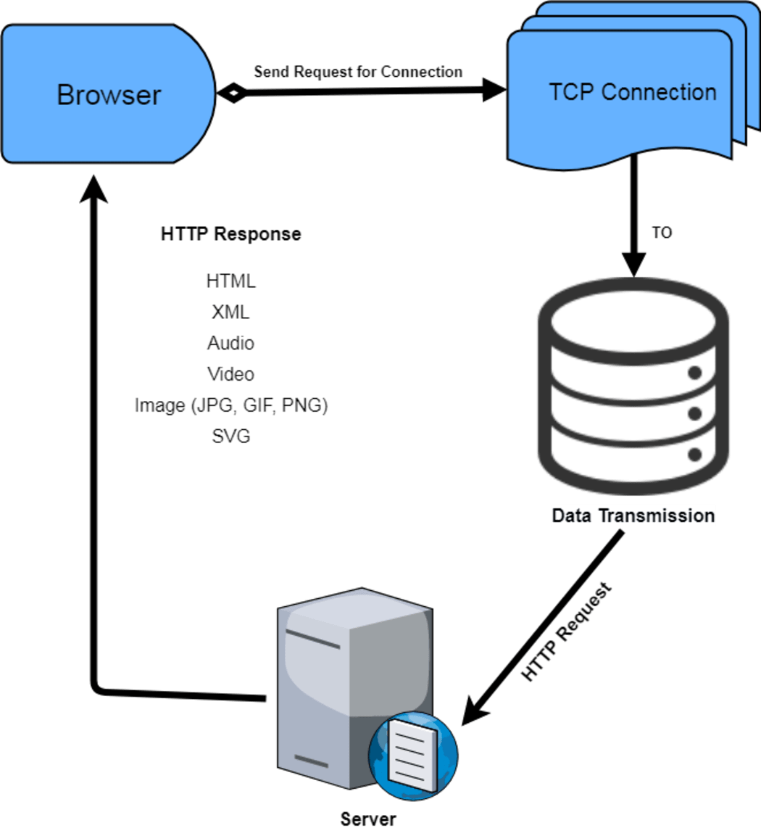

THREAD

Slide 6
MULTITHREADING IN C#
In C#, the System.Threading.Thread class is used for working with threads.
It allows creating and accessing individual threads in a multithreaded application.
The first thread to be executed in a process is called the main thread.
When a C# program starts execution, the main thread is automatically created.
The threads created using the Thread class are called the child threads of the main thread. Thread can be accessed using the CurrentThread property of the Thread class.

Slide 7
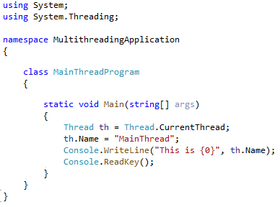
MULTITHREADING IN C# : EXAMPLE

Slide 8
THREAD LIFE CYCLE
The Unstarted State
− It is the situation when the instance of the thread is created but the Start method is not called.
The Ready State
− It is the situation when the thread is ready to run and waiting CPU cycle.
The Not Runnable State
− A thread is not executable, when
Sleep method has been called
Wait method has been called
Blocked by I/O operations
The Dead State
− It is the situation when the thread completes execution or is aborted

Slide 9
THREAD PROPERTIES
CurrentContext
Gets the current context in which the thread is executing.
CurrentThread
Gets the currently running thread
IsAlive
Gets a value indicating the execution status of the current thread.
IsBackground
Gets or sets a value indicating whether or not a thread is a background thread.
Name
Gets or sets the name of the thread.
Priority
Gets or sets a value indicating the scheduling priority of a thread.
ThreadState
Gets a value containing the states of the current thread.

Slide 10
THREAD METHODS
Start()
Starts a thread.
GetDomain()
Returns the current domain in which the current thread is running
GetDomainID()
Returns a unique application domain identifier
Sleep(int millisecondsTimeout)
Makes the thread pause for a period of time.
Join()
Blocks the calling thread until a thread terminates, while continuing to perform standard COM and SendMessage pumping. This method has different overloaded forms.
Interrupt()
Interrupts a thread that is in the WaitSleepJoin thread state.
Abort()
Raises a ThreadAbortException in the thread on which it is invoked, to begin the process of terminating the thread. Calling this method usually terminates the thread.

Slide 11
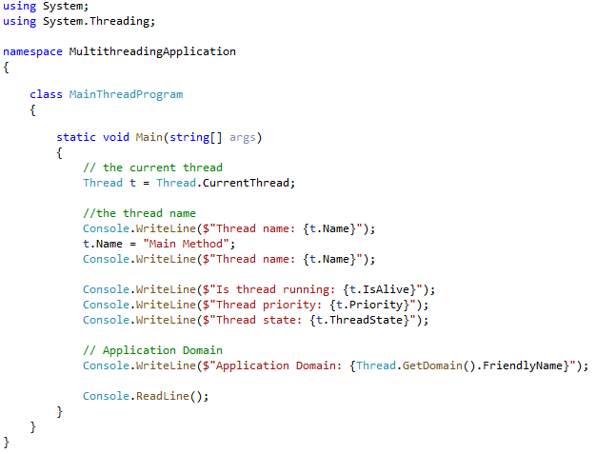
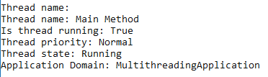
THREAD METHODS & PROPERTIES

Slide 12
THREAD STATES
Aborted
Thread is stopped but not finished
AbortRequested
Abort() method is already called but thread is not stopped yet
Background
Thread is running in the background mode
Running
Thread is working (not stopped or paused)
Stopped
Thread is finished
StopRequested
Thread has got request for stopping
Suspended
Thread is paused
SuspendRequested
Thread has got request for pause
Unstarted
Thread hasn’t been running yet
WaitSleepJoin
Thread is blocked by sleep() or join() meyhods

Slide 13
THREAD PRIORITIES
Lowest
BelowNormal
Normall
AboveNormal
Highest

Slide 14
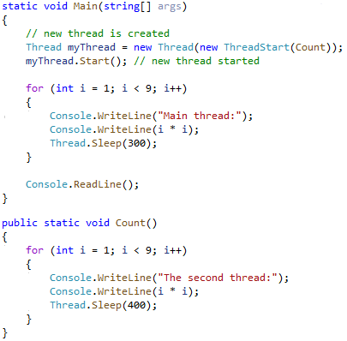
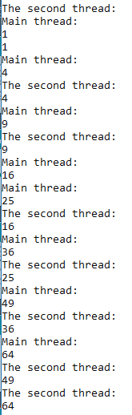
THREAD CREATION
To create new thread ThreadStart delegate should be used.
To start created thread we use Start() method.
Another way to create new thread is:
Thread myThread = new Thread(Count);

Slide 15
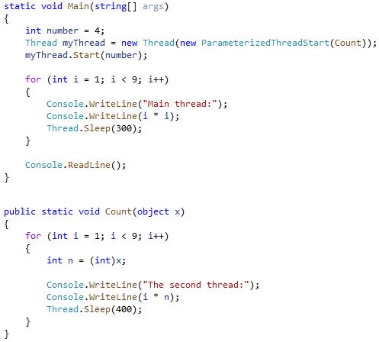
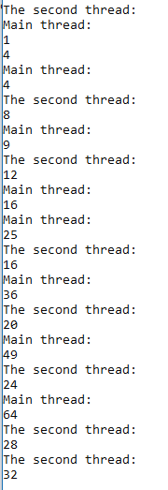
THREAD WITH PARAMETERS
To create the thread that can take some parameters ParameterizedThreadStart
delegate should be used.
Method that is executed within created thread can take single parameter of object type.
To pass more parameters we should use class.

Slide 16
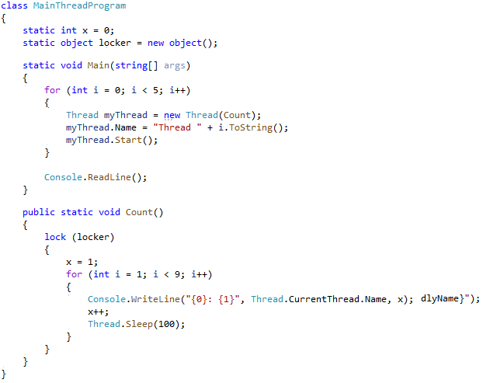
THREAD SYNCHRONIZING
Some resources can be used by a few threads.
To make the resources that are currently using by one thread unavailable for another ones, keyword the lock keyword should be used.

Slide 17
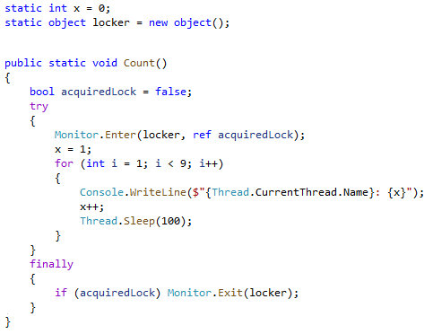
MONITOR
The other way to synchronize threads is using System.Thread.Monitor class.

Slide 18
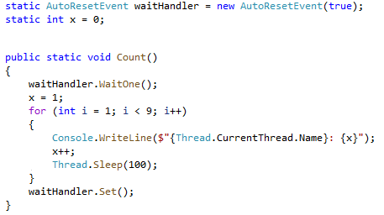
AutoResetEvent
One more way to synchronize threads is using AutoResetEvent class.

Slide 19
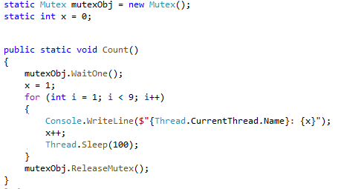
MUTEX
Class Mutex also can be used for locking the resources used by one thread for another threads.

Slide 20
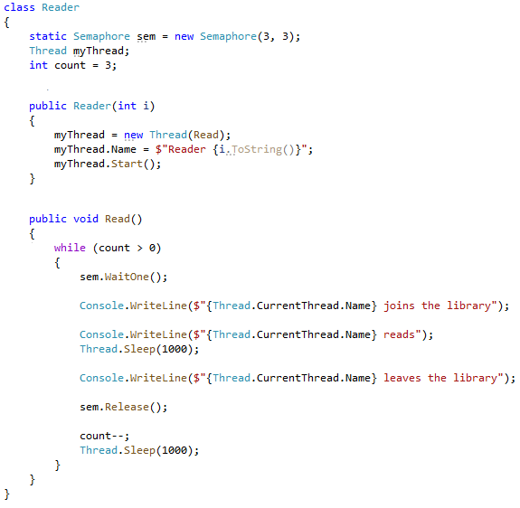
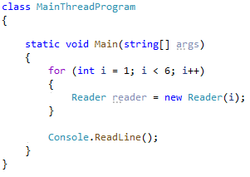
SEMAPHORE
Semaphore can be used to allow the access to resources for the setted amount of threads.

Slide 21
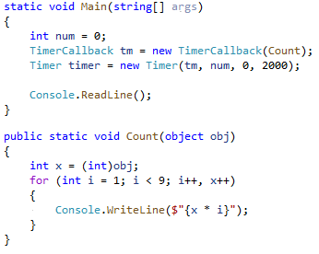
TIMER
Timer can be used to start some thread execution after the setted time passed.

Slide 22
USEFUL LINKS
https://channel9.msdn.com/Series/C-Advanced/Distinguish-Asynchronous-And-Multi-Threading--C-Advanced-8-of-8
https://docs.microsoft.com/en-us/dotnet/standard/threading/
https://vivadifferences.com/13-difference-between-process-and-thread-in-os/

Slide 23


